Slide 1
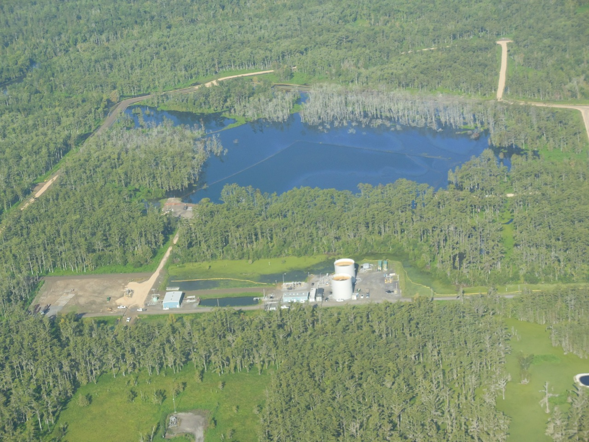
Gas Mitigation Program Residents out of homes 406 days—1 year, 1 month, 9 days
September 12, 2013

Slide 2
Gas Mitigation Program
Control shallow gas above the MRAA with dual-phase vapor extraction
Remove gas from MRAA using similar gas/water extraction

Slide 3
Respec Dual-Phase Vapor Extraction (DPVE) Pilot Test
Pilot test ran for a total of 219 hours.
DPVE test was shut down at 14:00 on September 6, 2013.
Total methane removed = 6.9 pounds per hour methane or ~4,000 scfd
Bubbles started to reappear at NSDBS-026 within 90 minutes of shut down.

Slide 4
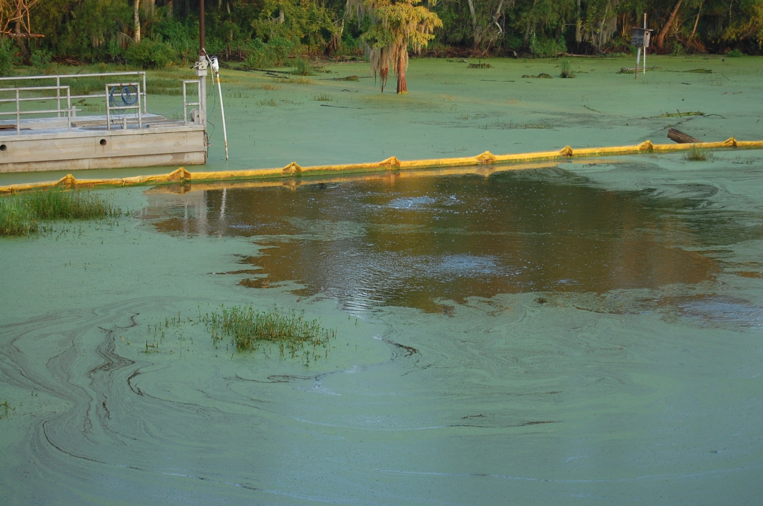
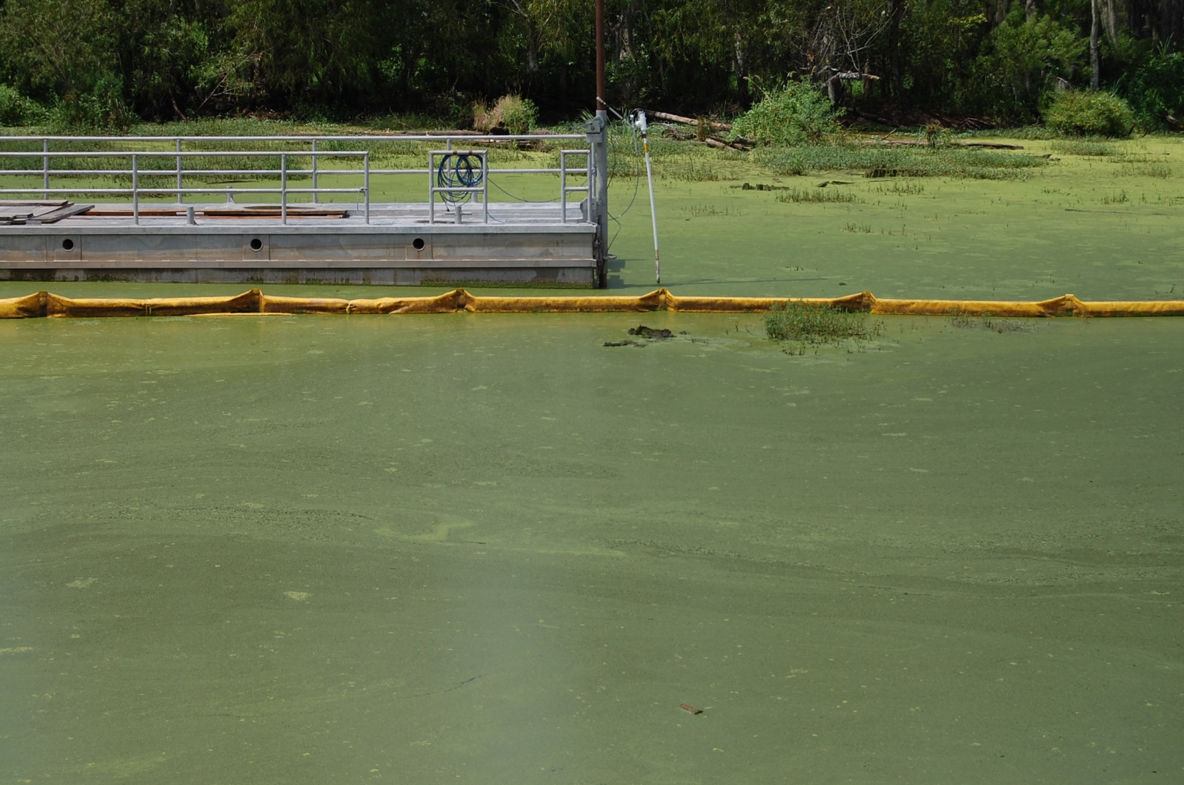
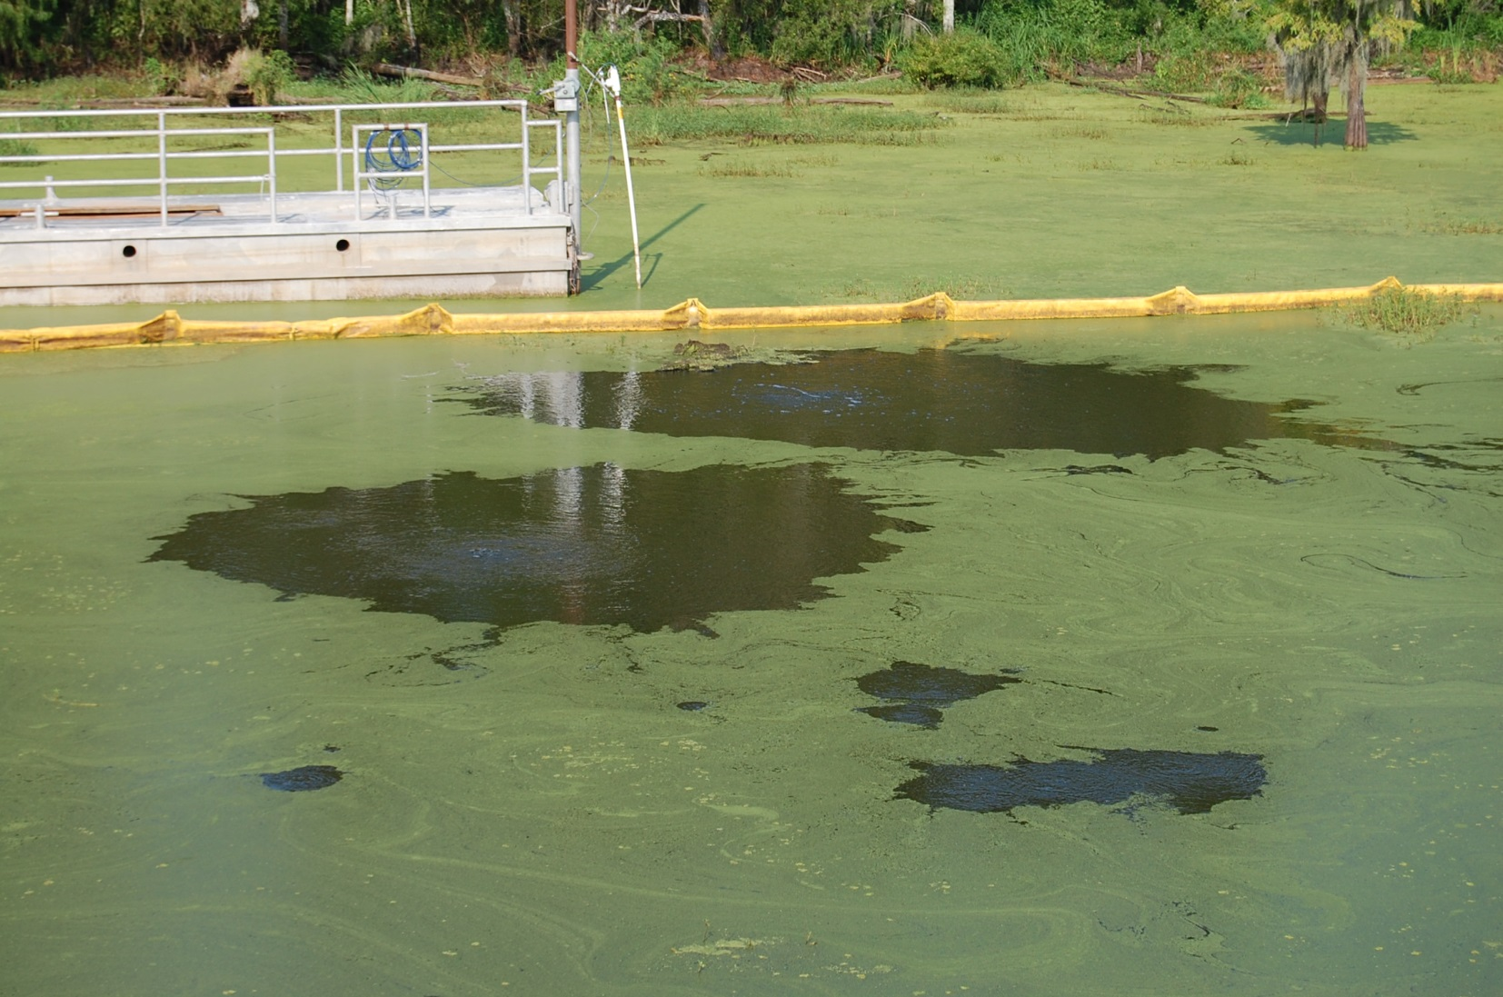
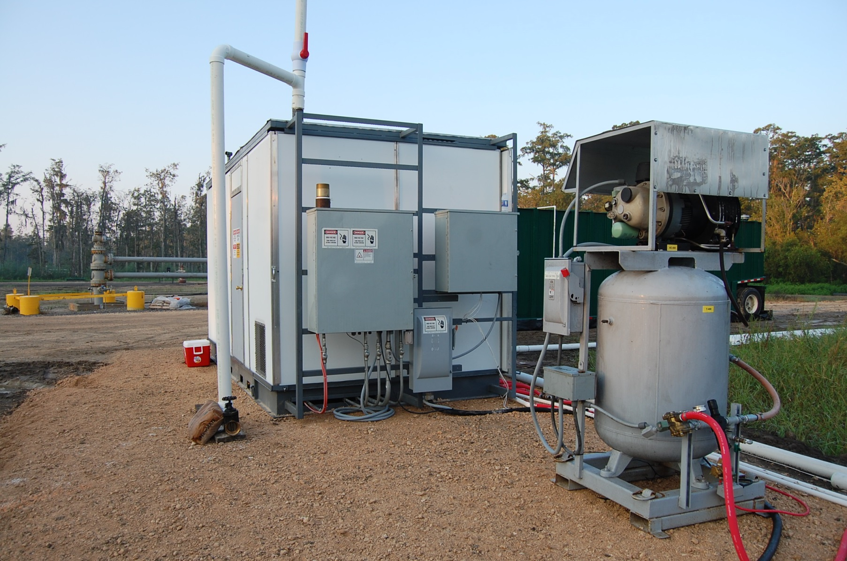
Dual Phase Vapor Extraction Pilot Test
PRIOR TO START UP
Wednesday August 28, 2013
07:30 AM
3 hours prior to startup
September 6
12:45
1 hour prior to shut down
September 10, 2013
4 days after shutdown
Forty horsepower oil-sealed dual phase liquid ring pump
Compressor
Very successful test conducted by Respec!

Slide 5

Dual-Phase Vapor Extraction System
Slab-on-grade
Crawl space
DPVE System
Clay Aquitard
Fine-grained sand
MRAA Aquifer
Gas

Slide 6
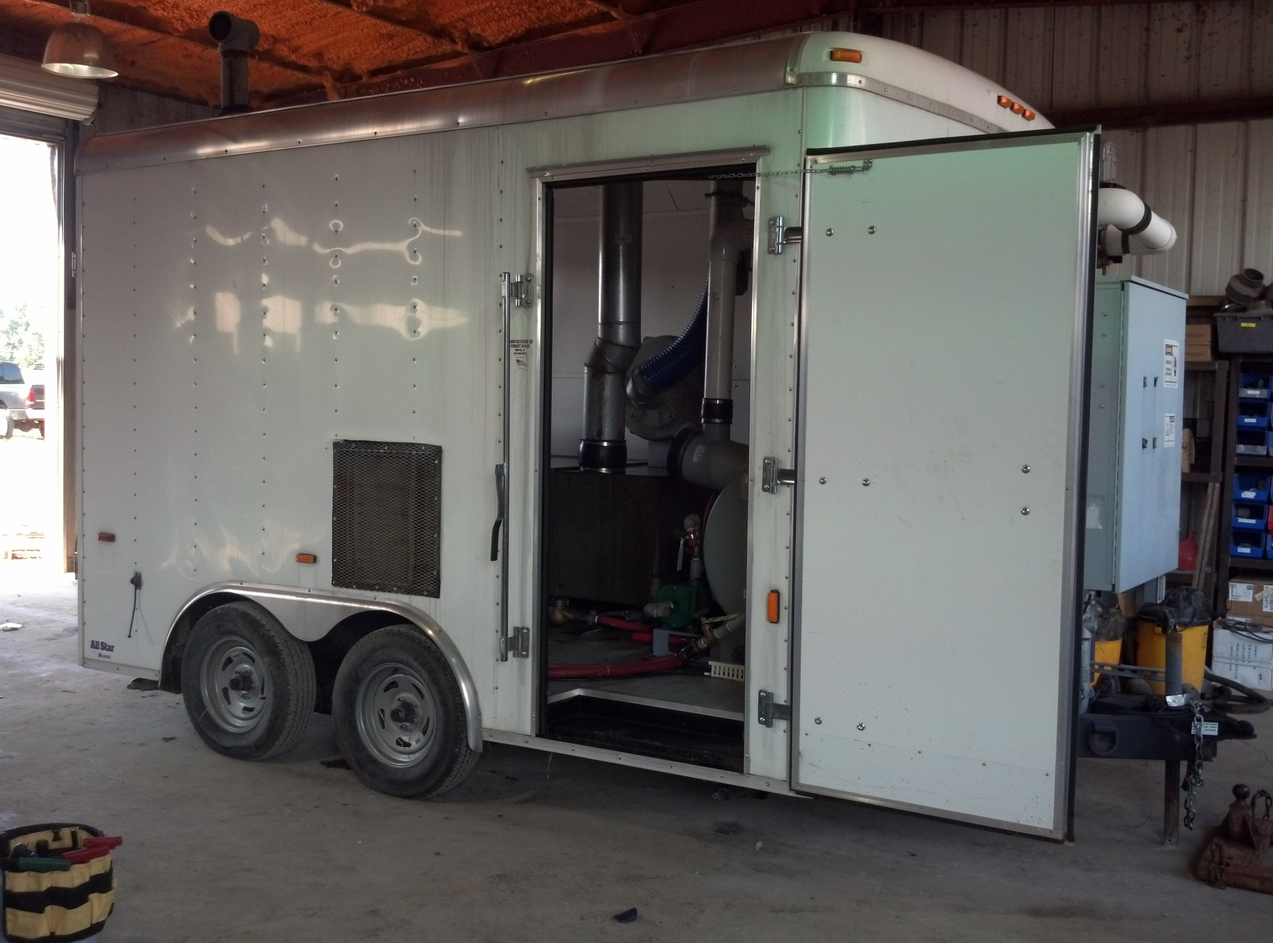
Trailer Mounted DPVE Unit

Slide 7
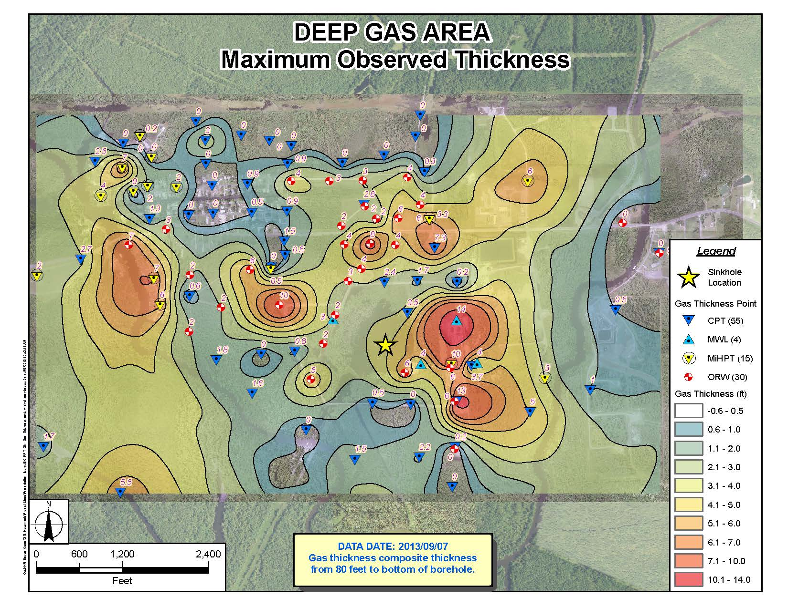

Slide 8
